Slide 1
SCIKIT-LEARN
Introduction and Installation

Slide 2
TABLE OF CONTENTS
01
02
03
Types of Machine Learning
Intro to sklearn
Histroy of sklearn

Slide 3
TABLE OF CONTENTS
04
05
06
Installation
Pros and Cons
Modules available in sklearn

Slide 4
01
Types of Machine Learning

Slide 5
Supervised Machine Learning
Training Data
Model
Training
Training Labels
Test Data
Prediction
Generalization
Test Labels
Evaluation

Slide 6
Unsupervised Machine Learning
Eg: pca = PCA()
pca.fit(X_train)
X_new = pca.transform(X_test)
Training Data
Model
Test Data
New View

Slide 7
02
Intro to sklearn

Slide 8
INTRODUCTION
Scikit-learn is an open source machine learning library that supports supervised and unsupervised learning. It also provides various tools for model fitting, data preprocessing, model selection and evaluation, and many other utilities.

Slide 9
What is sklearn
Scikit-learn (Sklearn) is the most useful and robust library for machine learning in Python. It provides a selection of efficient tools for machine learning and statistical modeling including classification, regression, clustering and dimensionality reduction via a consistence interface in Python. This library, which is largely written in Python, is built upon NumPy, SciPy and Matplotlib.

Slide 10
Basic API
estimator.fit( X , [y] )
estimator.predict
estimator.transform
Classification
Regression
Clustering
Preprocessing
Dimensionality reduction
Feature selection
Feature extraction

Slide 11
Example of Estimator API
1)Importing the Model:
from sklearn.linear_model import LinearRegression
2)Estimator parameter:
model = LinearRegression(normalize = True)
3)Split data:
form sklearn.cross_validation import train_test_split
X, y = np.arrange(10).reshape( (5,2) ).range(5)
X_train, X_test, y_train, y_test = train_test_split( X, y, test_size = 0.3 )

Slide 12
Example of Estimator API
4)Fit the Model:
model.fit( X_train, y_train )
5)Predicting the test data:
Predictions = model.predict( X_test )
6)Evaluation is done at the last
Note : model.predict_probe() – It returns the probability that a new obstruction has each label
model.score() – measuring the accuracy of the model against the training data

Slide 13
03
Histroy of sklearn

Slide 14
Origin of sklearn
It was originally called scikits.learn and was initially developed by David Cournapeau as a Google summer of code project in 2007. Later, in 2010, Fabian Pedregosa, Gael Varoquaux, Alexandre Gramfort, and Vincent Michel, from FIRCA (French Institute for Research in Computer Science and Automation), took this project at another level and made the first public release (v0.1 beta) on 1st Feb. 2010..

Slide 15
Version History
Versions (sklearn) | Year | Major changes
0.18.0 | Sept 2016 | Model Selection Enhancements and API Changes
0.19.0 | July 2017 | Added multioutput.ClassifierChain
0.20.0 | Sept 2018 | Bug fixes, Changed models & Enchanments
0.21.0 | May 2019 | Added cluster.OPTICS algorithm
0.22.0 | Dec 2019 | Bug fixes
0.23.0 | May 2020 | The critical parts of cluster.KMeans have a more optimized implementation.
0.24.0 | Jan 2021 | Added ensemble.HistGradientBoostingRegressor and ensemble.HistGradientBoostingClassifier
1.0 | Sept 2021 | calibration.CalibrationDisplay added to plot calibration curves.

Slide 16
04
Installation

Slide 17
Installation Prerequisites
Before we start using scikit-learn latest release, we require the following −
Python (>=3.5)
NumPy (>= 1.11.0)
Scipy (>= 0.17.0)li
Joblib (>= 0.11)
Matplotlib (>= 1.5.1) is required for Sklearn plotting capabilities.
Pandas (>= 0.18.0) is required for some of the scikit-learn examples using data structure and analysis.

Slide 18
Installation
Following command can be used to install scikit-learn via pip −
Using pip
$ pip install –U scikit-learn
Using conda
Following command can be used to install scikit-learn via conda −
$ conda install scikit-learn

Slide 19
05
Pros and Cons

Slide 20
Pros and cons
Pros: The library is distributed under the BSD license, making it free with minimum legal and licensing restrictions. It is easy to use. The scikit-learn library is very versatile and handy and serves real-world purposes like the prediction of consumer behavior, the creation of neuroimages, etc. Scikit-learn is backed and updated by numerous authors, contributors, and a vast international online community. The scikit-learn website provides elaborate API documentation for users who want to integrate the algorithms with their platforms. Con: It is not the best choice for in-depth learning

Slide 21
06
Modules in sklearn

Slide 22
sklearn.covarience
The sklearn.covariance module includes methods and algorithms to robustly estimate the covariance of features given a set of points. The precision matrix defined as the inverse of the covariance is also estimated. Covariance estimation is closely related to the theory of Gaussian Graphical Models.

Slide 23
Covarience Estimators
covariance.EmpiricalCovariance(*[, …]) Maximum likelihood covariance estimator.
covariance.EllipticEnvelope(*[, …]) An object for detecting outliers in a Gaussian distributed dataset.
covariance.GraphicalLasso([alpha, mode, …]) Sparse inverse covariance estimation with an l1-penalized estimator.
covariance.GraphicalLassoCV(*[, alphas, …]) Sparse inverse covariance w/ cross-validated choice of the l1 penalty.
covariance.LedoitWolf(*[, store_precision, …]) LedoitWolf Estimator.
covariance.MinCovDet(*[, store_precision, …]) Minimum Covariance Determinant (MCD): robust estimator of covariance.
covariance.OAS(*[, store_precision, …]) Oracle Approximating Shrinkage Estimator.
covariance.ShrunkCovariance(*[, …]) Covariance estimator with shrinkage.
covariance.empirical_covariance(X, *[, …]) Computes the Maximum likelihood covariance estimator
covariance.graphical_lasso(emp_cov, alpha, *) l1-penalized covariance estimator
covariance.ledoit_wolf(X, *[, …]) Estimates the shrunk Ledoit-Wolf covariance matrix.
covariance.oas(X, *[, assume_centered]) Estimate covariance with the Oracle Approximating Shrinkage algorithm.
covariance.shrunk_covariance(emp_cov[, …]) Calculates a covariance matrix shrunk on the diagonalA

Slide 24
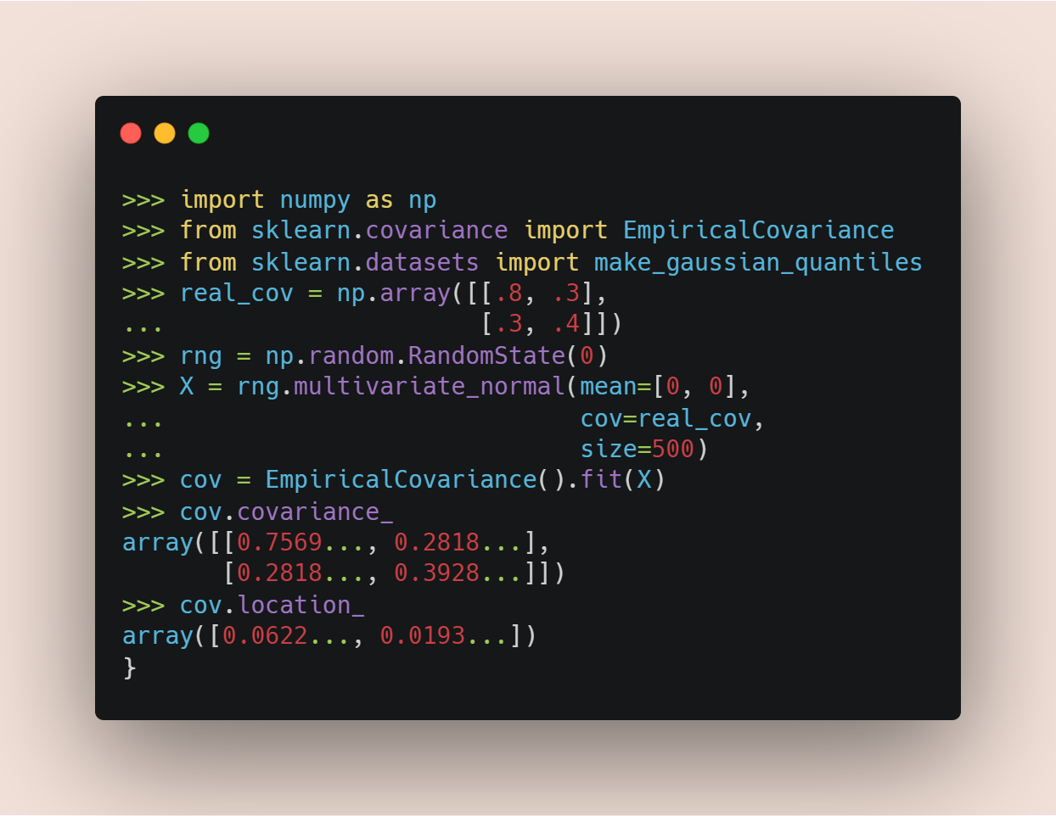
Example: sklearn.covariance.EmpiricalCovariance

Slide 25
sklearn.datasets
The sklearn.datasets module includes utilities to load datasets, including methods to load and fetch popular reference datasets. It also features some artificial data generators.

Slide 26
Datasets - Loaders
datasets.load_boston(*[, return_X_y]) DEPRECATED: load_boston is deprecated in 1.0 and will be removed in 1.2.
datasets.load_breast_cancer(*[, return_X_y, …]) Load and return the breast cancer wisconsin dataset (classification).
datasets.load_diabetes(*[, return_X_y, as_frame]) Load and return the diabetes dataset (regression).
datasets.load_digits(*[, n_class, …]) Load and return the digits dataset (classification).
datasets.load_files(container_path, *[, …]) Load text files with categories as subfolder names.
datasets.load_iris(*[, return_X_y, as_frame]) Load and return the iris dataset (classification).
datasets.load_linnerud(*[, return_X_y, as_frame]) Load and return the physical exercise Linnerud dataset.
datasets.load_sample_image(image_name) Load the numpy array of a single sample image
datasets.load_sample_images() Load sample images for image manipulation.
datasets.load_svmlight_file(f, *[, …]) Load datasets in the svmlight / libsvm format into sparse CSR matrix
datasets.load_svmlight_files(files, *[, …]) Load dataset from multiple files in SVMlight format
datasets.load_wine(*[, return_X_y, as_frame]) Load and return the wine dataset (classification).

Slide 27
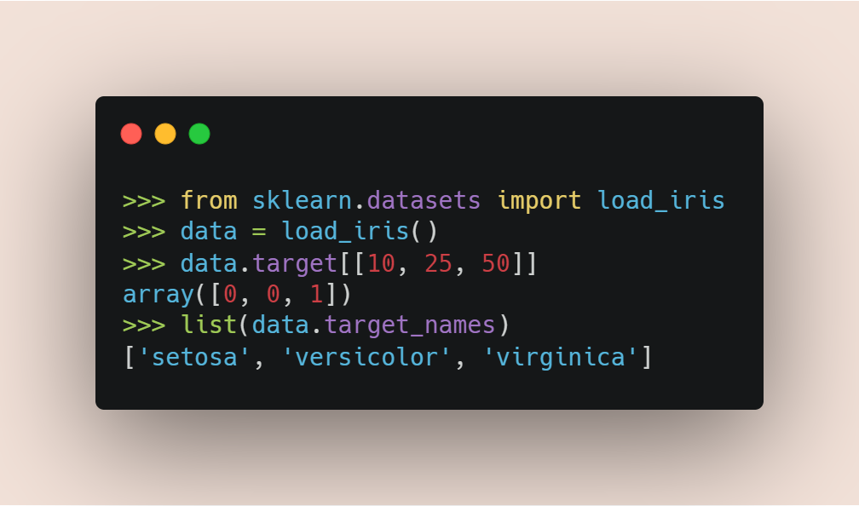
Example: sklearn.datasets.load_iris

Slide 28
Datasets – Sample generators
datasets.make_biclusters(shape, n_clusters, *) Generate an array with constant block diagonal structure for biclustering.
datasets.make_blobs([n_samples, n_features, …]) Generate isotropic Gaussian blobs for clustering.
datasets.make_checkerboard(shape, n_clusters, *) Generate an array with block checkerboard structure for biclustering.
datasets.make_circles([n_samples, shuffle, …]) Make a large circle containing a smaller circle in 2d.
datasets.make_classification([n_samples, …]) Generate a random n-class classification problem.
datasets.make_friedman1([n_samples, …]) Generate the “Friedman #1” regression problem..
datasets.make_gaussian_quantiles(*[, mean, …]) Generate isotropic Gaussian and label samples by quantile.
datasets.make_hastie_10_2([n_samples, …] Generates data for binary classification used in Hastie et al. 2009, Example 10.2.
datasets.make_low_rank_matrix([n_samples, …]) Generate a mostly low rank matrix with bell-shaped singular values.
datasets.make_moons([n_samples, shuffle, …]) Make two interleaving half circles.

Slide 29
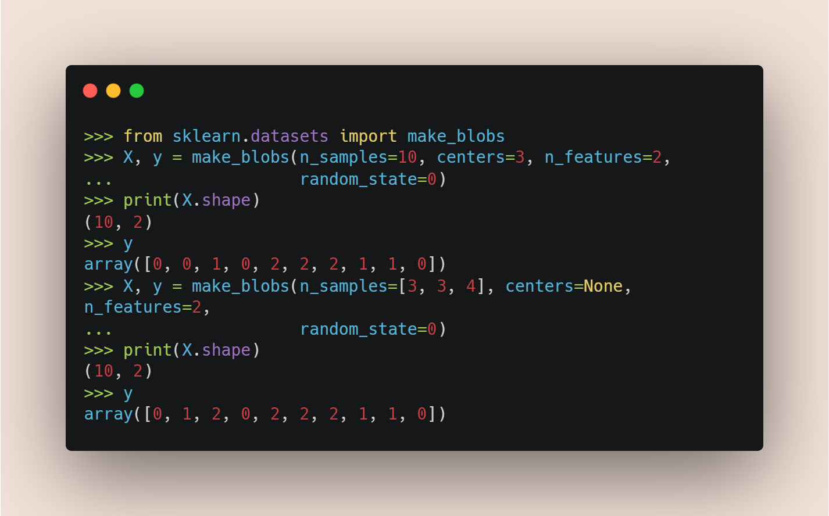
Example: sklearn.datasets.make_blobs

Slide 30
sklearn.exceptions
The sklearn.exceptions module includes all custom warnings and error classes used across scikit-learn.

Slide 31
Exceptions and warnings
exceptions.ConvergenceWarning - Custom warning to capture convergence problems
exceptions.DataConversionWarning - Warning used to notify implicit data conversions happening in the code.
exceptions.DataDimensionalityWarning - Custom warning to notify potential issues with data dimensionality.
exceptions.EfficiencyWarning - Warning used to notify the user of inefficient computation.
exceptions.FitFailedWarning - Warning class used if there is an error while fitting the estimator.
exceptions.NotFittedError - Exception class to raise if estimator is used before fitting.
exceptions.UndefinedMetricWarning - Warning used when the metric is invalid

Slide 32
sklearn.pipeline
The sklearn.pipeline module implements utilities to build a composite estimator, as a chain of transforms and estimators.

Slide 33
Pipeline
pipeline.FeatureUnion(transformer_list, *[, …]) Concatenates results of multiple transformer objects.
pipeline.Pipeline(steps, *[, memory, verbose]) Pipeline of transforms with a final estimator.
pipeline.make_pipeline(*steps[, memory, verbose]) Construct a Pipeline from the given estimators.
pipeline.make_union(*transformers[, n_jobs, …]) Construct a FeatureUnion from the given transformers

Slide 34
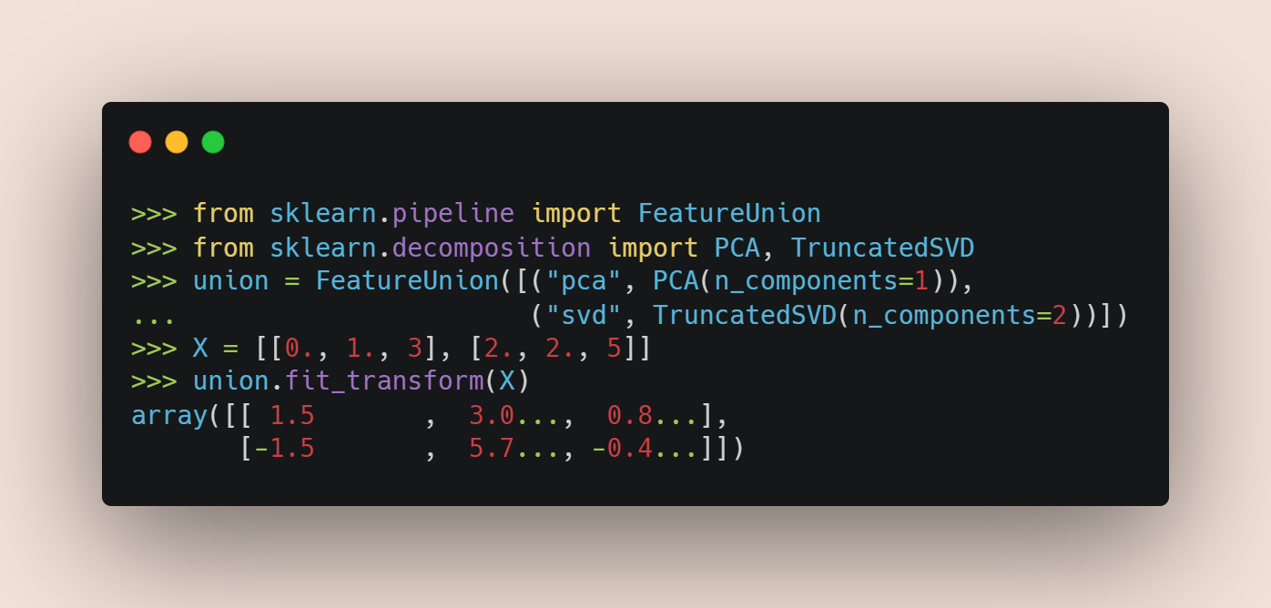
Example: sklearn.pipeline.FeatureUnion

Slide 36
Fonts & colors used
This presentation has been made using the following fonts:
Poiret One
(https://fonts.google.com/specimen/Poiret+One)
Oxygen Regular
(https://fonts.google.com/specimen/Oxygen)
#6d5b57
#f2e1d8
#595959
#b08980

Slide 37
Use our editable graphic resources...
You can easily resize these resources without losing quality. To change the color, just ungroup the resource and click on the object you want to change. Then, click on the paint bucket and select the color you want. Group the resource again when you’re done. You can also look for more infographics on Slidesgo.

Slide 39
JANUARY
FEBRUARY
MARCH
APRIL
MAY
JUNE
PHASE 1
Task 1
Task 2
PHASE 2
Task 1
Task 2
JANUARY
FEBRUARY
MARCH
APRIL
PHASE 1
Task 1
Task 2

Slide 42
...and our sets of editable icons
You can resize these icons without losing quality.
You can change the stroke and fill color; just select the icon and click on the paint bucket/pen.
In Google Slides, you can also use Flaticon’s extension, allowing you to customize and add even more icons.

Slide 43
Educational Icons
Medical Icons

Slide 44
Business Icons
Teamwork Icons

Slide 45
Help & Support Icons
Avatar Icons

Slide 46
Creative Process Icons
Performing Arts Icons

Slide 47
Nature Icons

